Slide 1
Sports Achievements

Slide 2
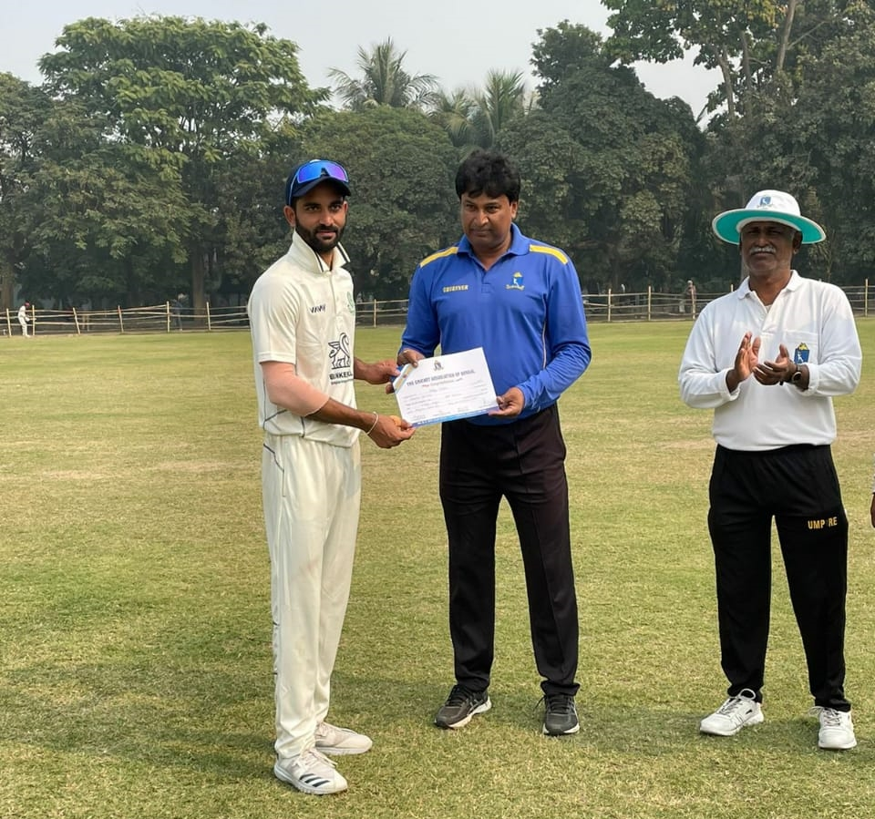
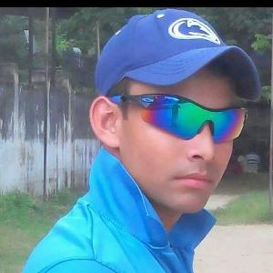
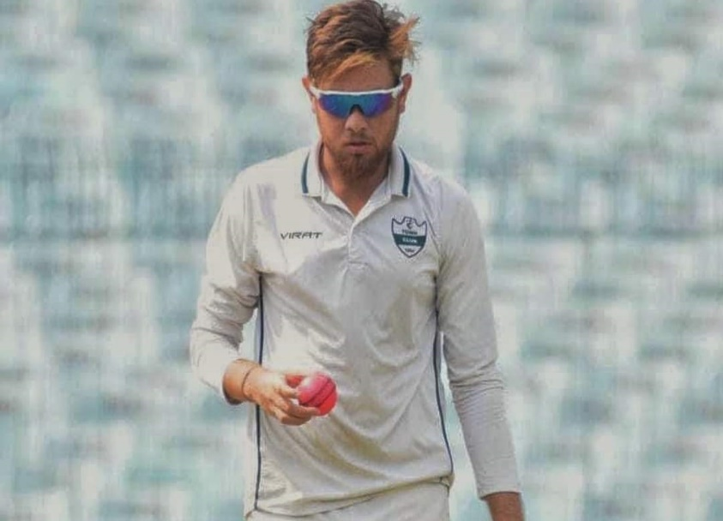
Cricket Players from this College In Bengal Cricket Team 1. Aditya Purohit 2. Ayan Bhattacharjee 3. Shreyan Chakraborty

Slide 3
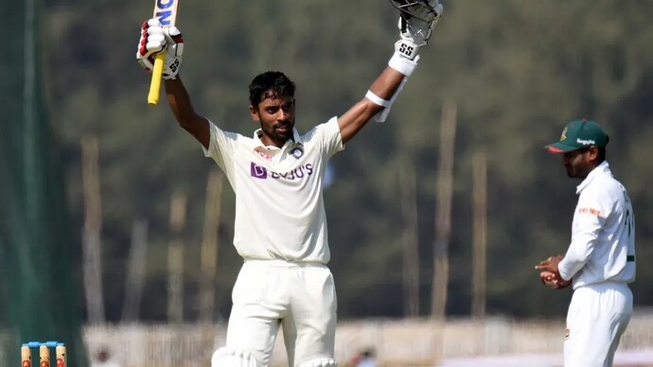
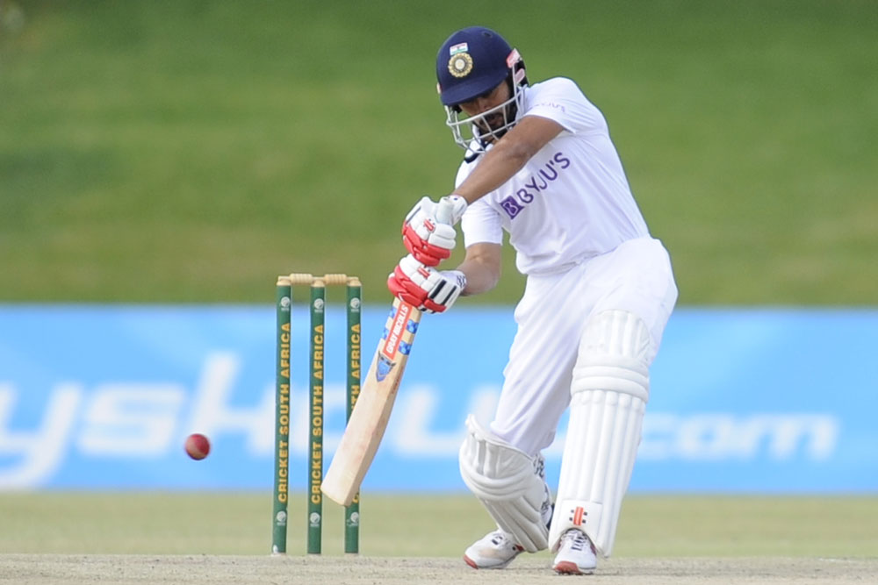
Achievements in International Level In Indian Cricket Team
Abhimunya Eswarayan
He made his Twenty20 debut for Bengal in the 2016–17 Inter State Twenty-20 Tournament on 31 January 2017. In October 2018, he was named in India A's squad for the 2018–19 Deodhar Trophy. He was the leading run-scorer for Bengal in the 2018–19 Ranji Trophy, with 861 runs in six matches.
In August 2019, he was named in the India Red team's squad for the 2019–20 Duleep Trophy. In the final of the tournament, he scored 153 runs against India Green. In October 2019, he was named in India A's squad for the 2019–20 Deodhar Trophy.
In January 2021, he was named as one of five standby players in India's Test squad for their home series against England. In May 2021, he was also named as one of four standby players in India's Test squad for the final of the 2019–2021 ICC World Test Championship and their away series against England.

Slide 4
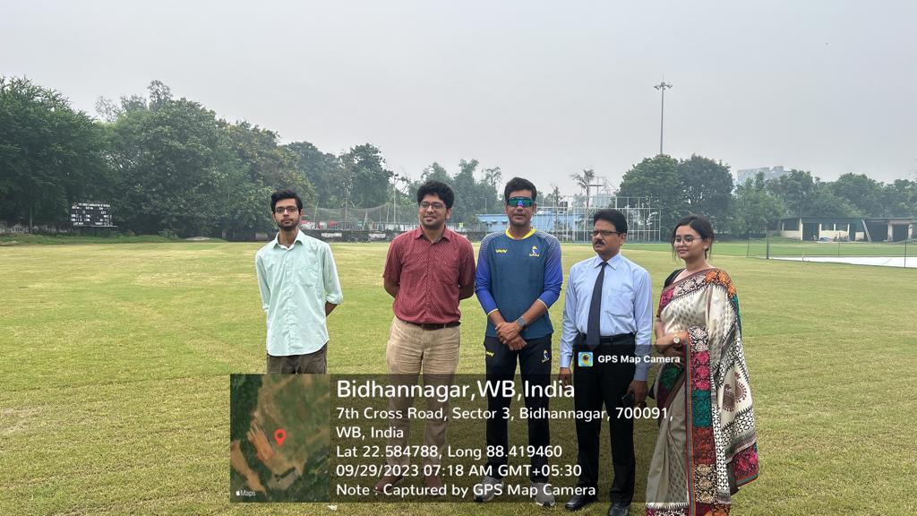
Former Indian Cricketer From this College
Laxmi Ratan Shukla
Because of impressive performances in domestic level Shukla got a national call in 1999. He was dropped in favour of Ashish Nehra in the first Test he was selected to play, against Sri Lanka at Colombo in the Asian Test Championship, even after his name appeared in the 11-member squad flashed on the electronic scoreboard at the ground. He made his ODI debut against Sri Lanka on 22 March 1999 in Nagpur. He played his last ODI against West Indies in 1999.

Slide 5
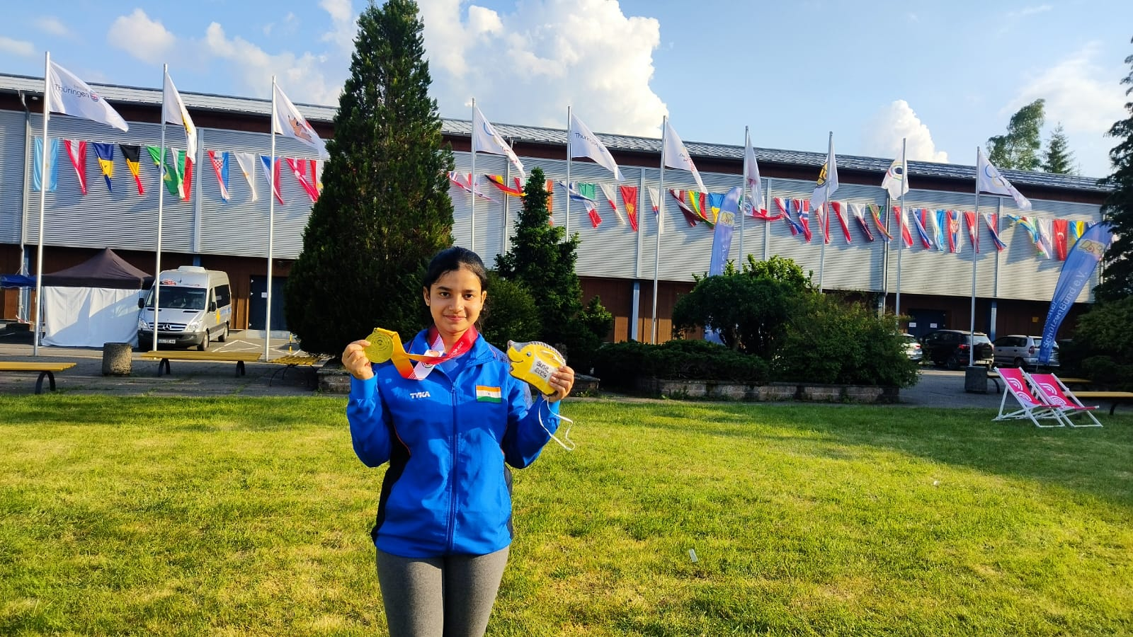
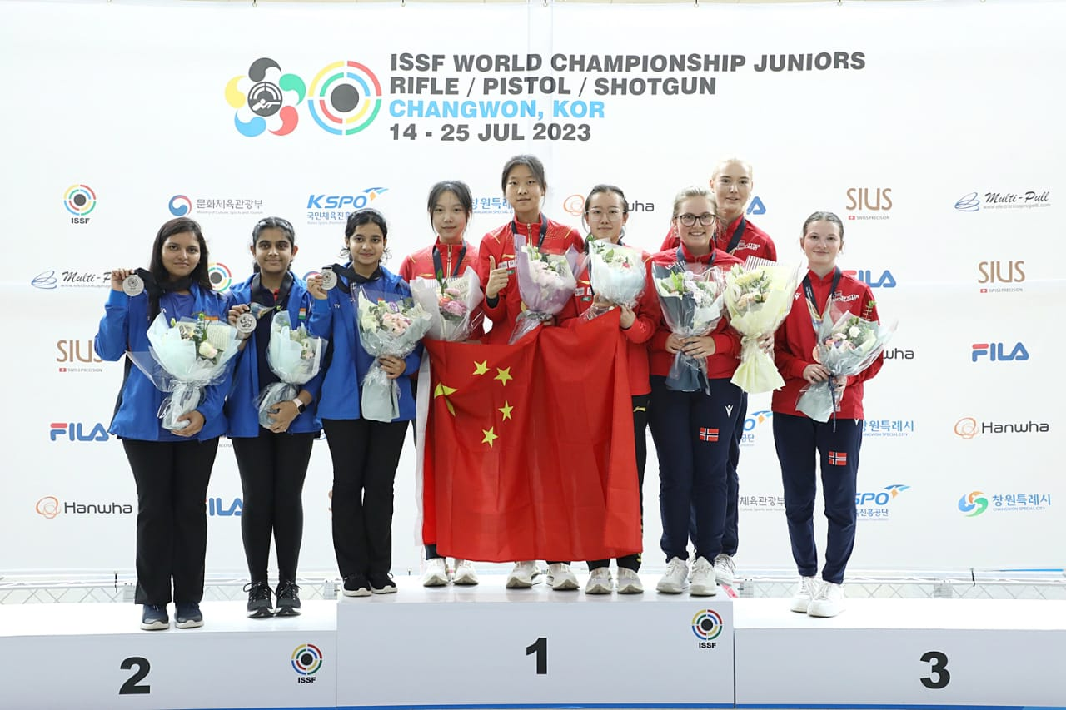
Achievements in International Level ISSF WORLD CHAMPIONSHIP JUNIORS KOREA(JULY, 2023) 10M AIR RIFLE WOMEN JUNIOR TEAM (SILVER)
Swati Chowdhury

Slide 6
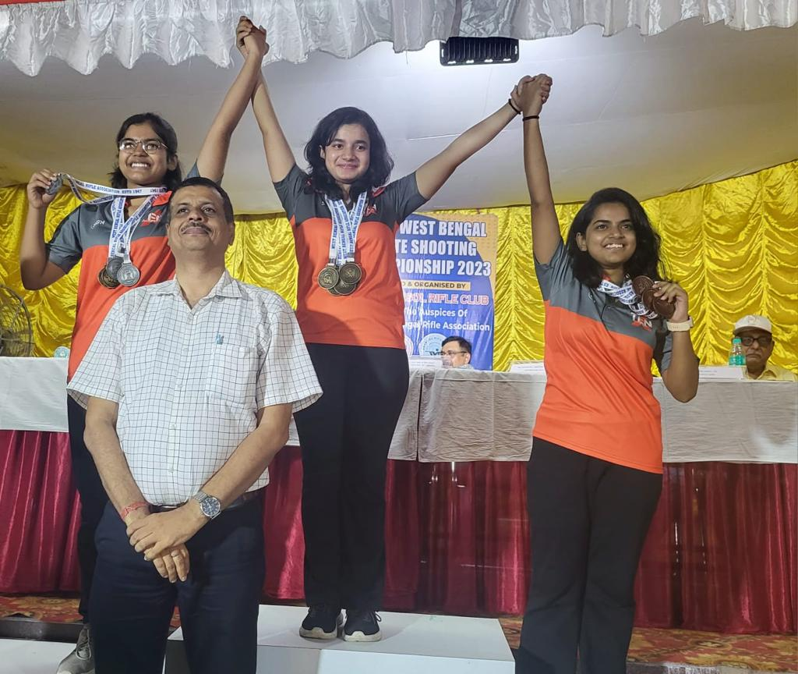
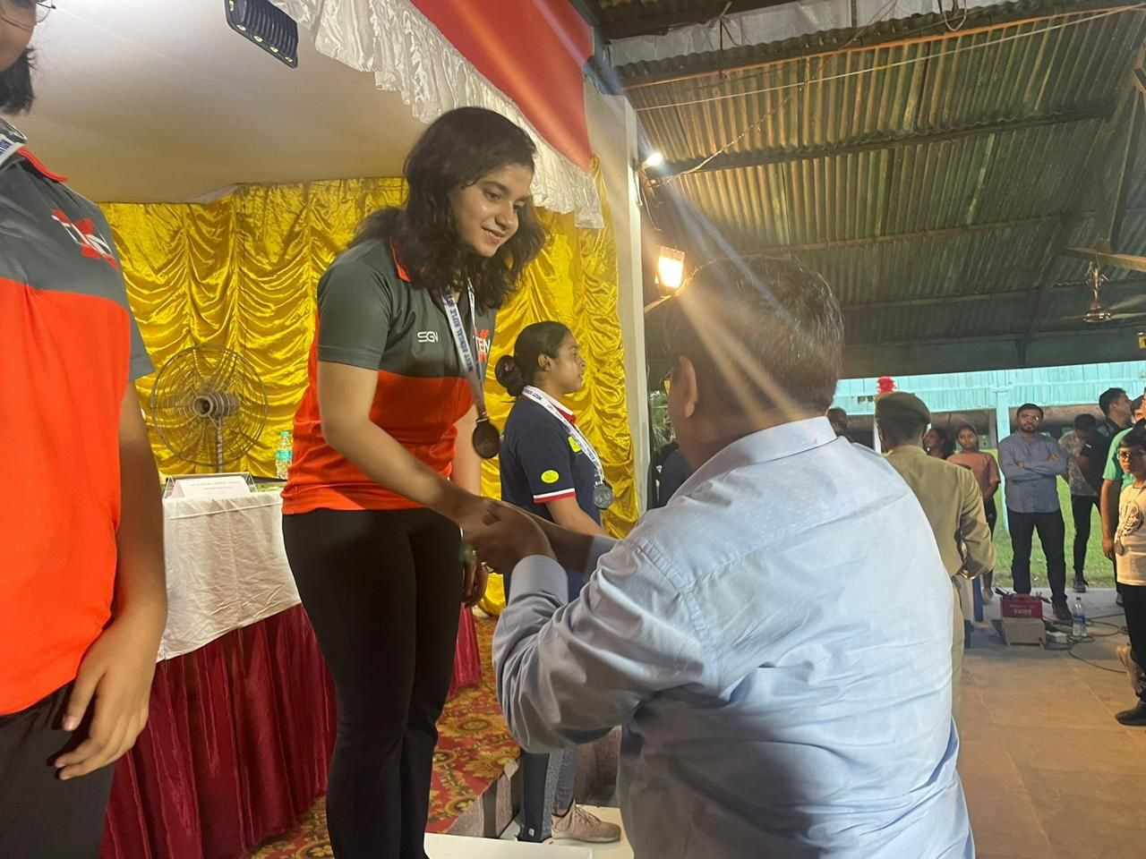
Achievements in state level WB SHOOTING CHAMPIONSHIP(RIFLE & PISTOL) 10M RIFEL CHAMPIONSHIP WOMEN (TEAM (3) & INDIVIDUAL(3))
Swati Chowdhury

